Slide 1
Sonia Delaunay
Rhythm

Slide 2
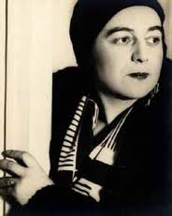
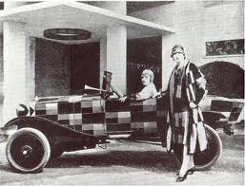
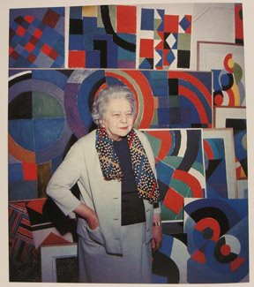
Artist designer Wife Mom
Jewish-French artist (1855-1979)
Known as one of the most important woman artists
Wife of Robert Delaunay, another important artist
Had many different “roles”
Used bright colors and geometric shapes

Slide 3
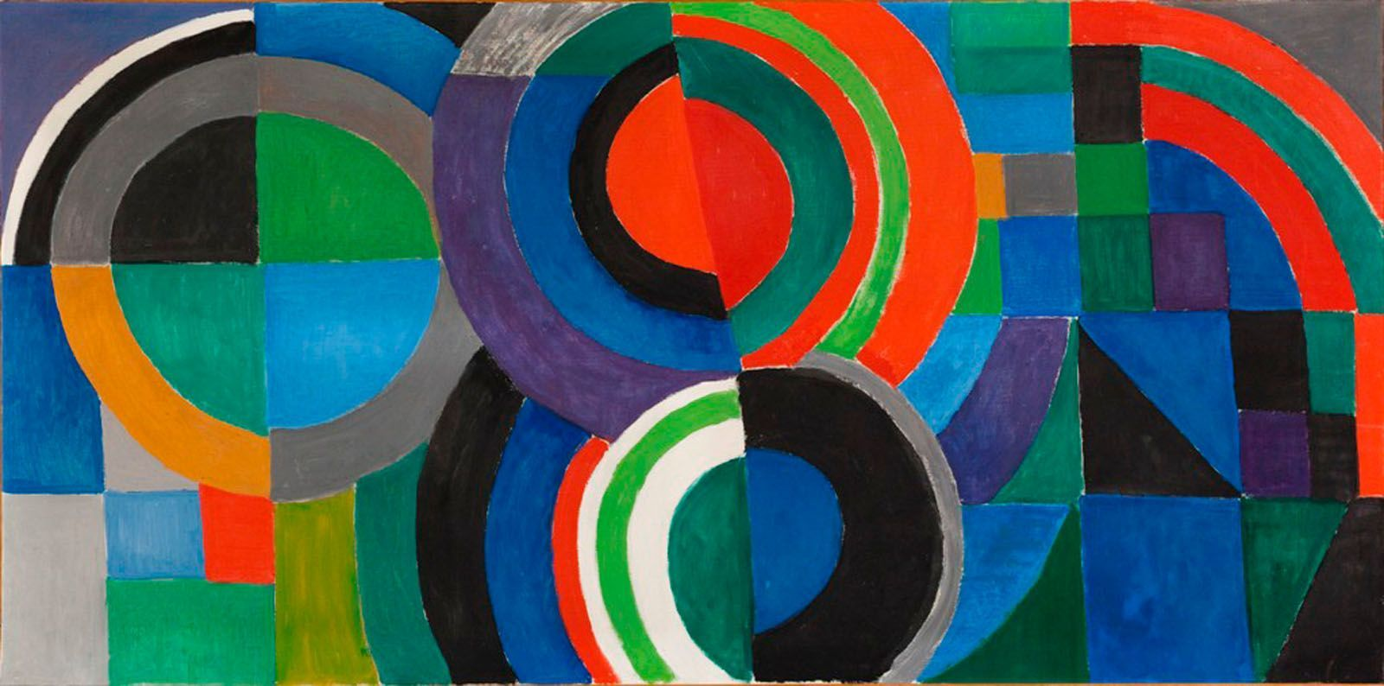
The Ukrain
Sonia Delaunay was born in Russia in 1885 and raised by her Aunt and Uncle in St. Petersburg. Her artistic ability was recognized at an early age. She married Robert Delaunay, another very famous artist. She sometimes collaborated with her husband and other artists.

Slide 4
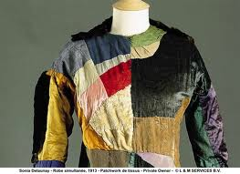
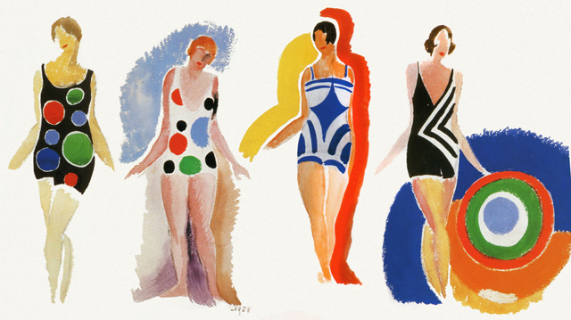
Fashion and Design
Sonia Delaunay designed fabric, clothes, sets, and furniture. Even Hollywood actresses wore her designs.

Slide 5
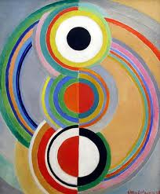
Rhythm
What colors do you see?
What does this painting make you think of?
How does this painting make you feel?
Is this a realistic or abstract piece of art?
Why do you think this piece is called Rhythm?
What name would you give this piece?

